Slide 1
Operational Amplifier its types & instrumentationalamplifier

Slide 2
Outlines
1.1 Introduction
1.2 Inverting Operational Amplifier
1.3 Non Inverting Operational Amplifier
1.4 Types of Operational Amplifier
1.4.1 Adder / Summer Operational Amplifier
1.4.2 Subtractor
1.4.3 Differentiator
1.4.4 Integrator
1.5 Instrumentational Amplifier

Slide 3
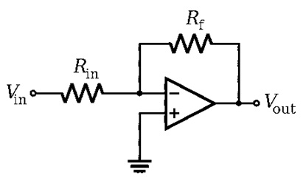
inverting operational amplifier
In this type of amplifier, the o/p is precisely 180 degrees out of phase to input. When the +Ve voltage is applied to the circuit, then the o/p of the circuit will be –Ve.

Slide 4
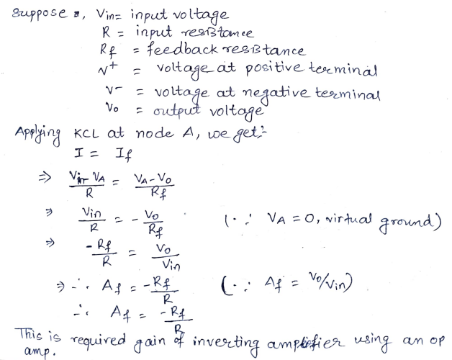

Slide 5
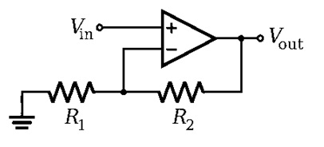
Non inverting operational amplifier
In this kind of amplifier, the output is exactly in phase to input. When a +Ve voltage is applied to the circuit, then the o/p will be positive.

Slide 6
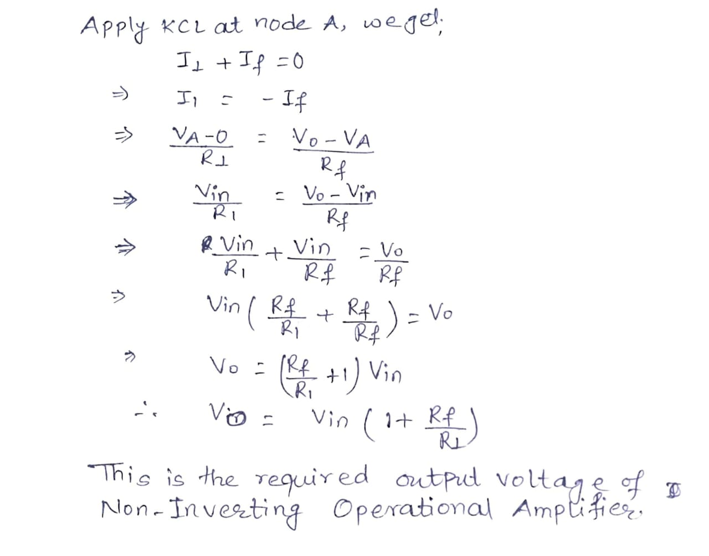

Slide 8
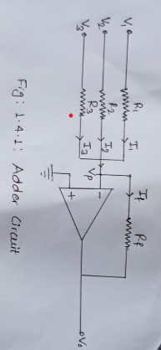
1.4 Types of Operational Amplifier1
1.4.1 Adder / Summer Operational Amplifier

Slide 9
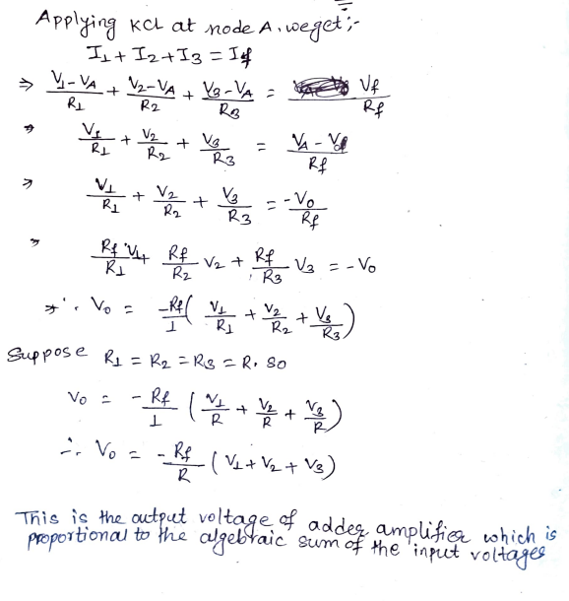

Slide 10
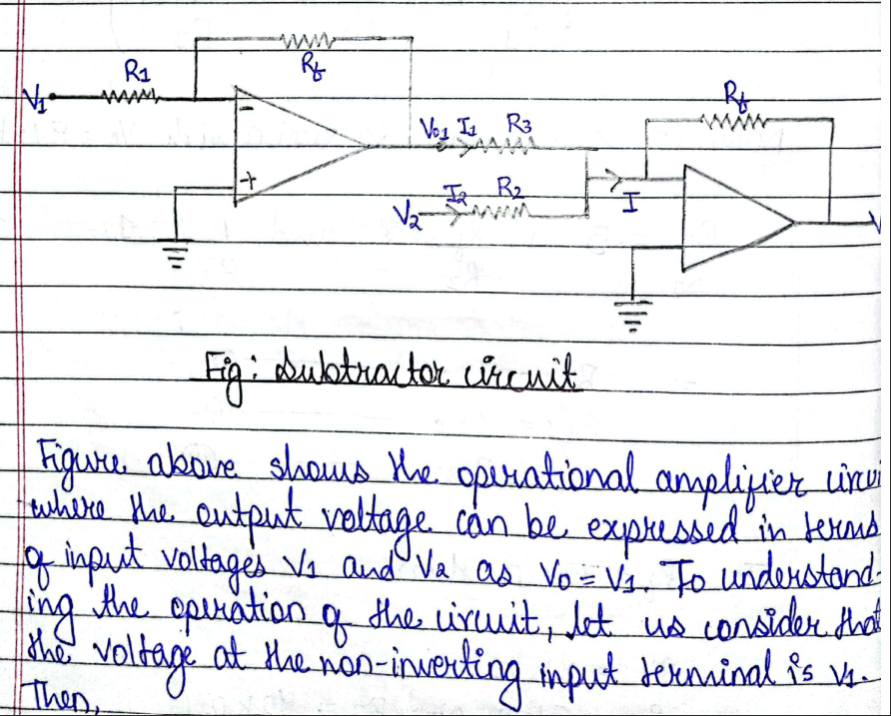
1.4.2 Subtractor

Slide 11
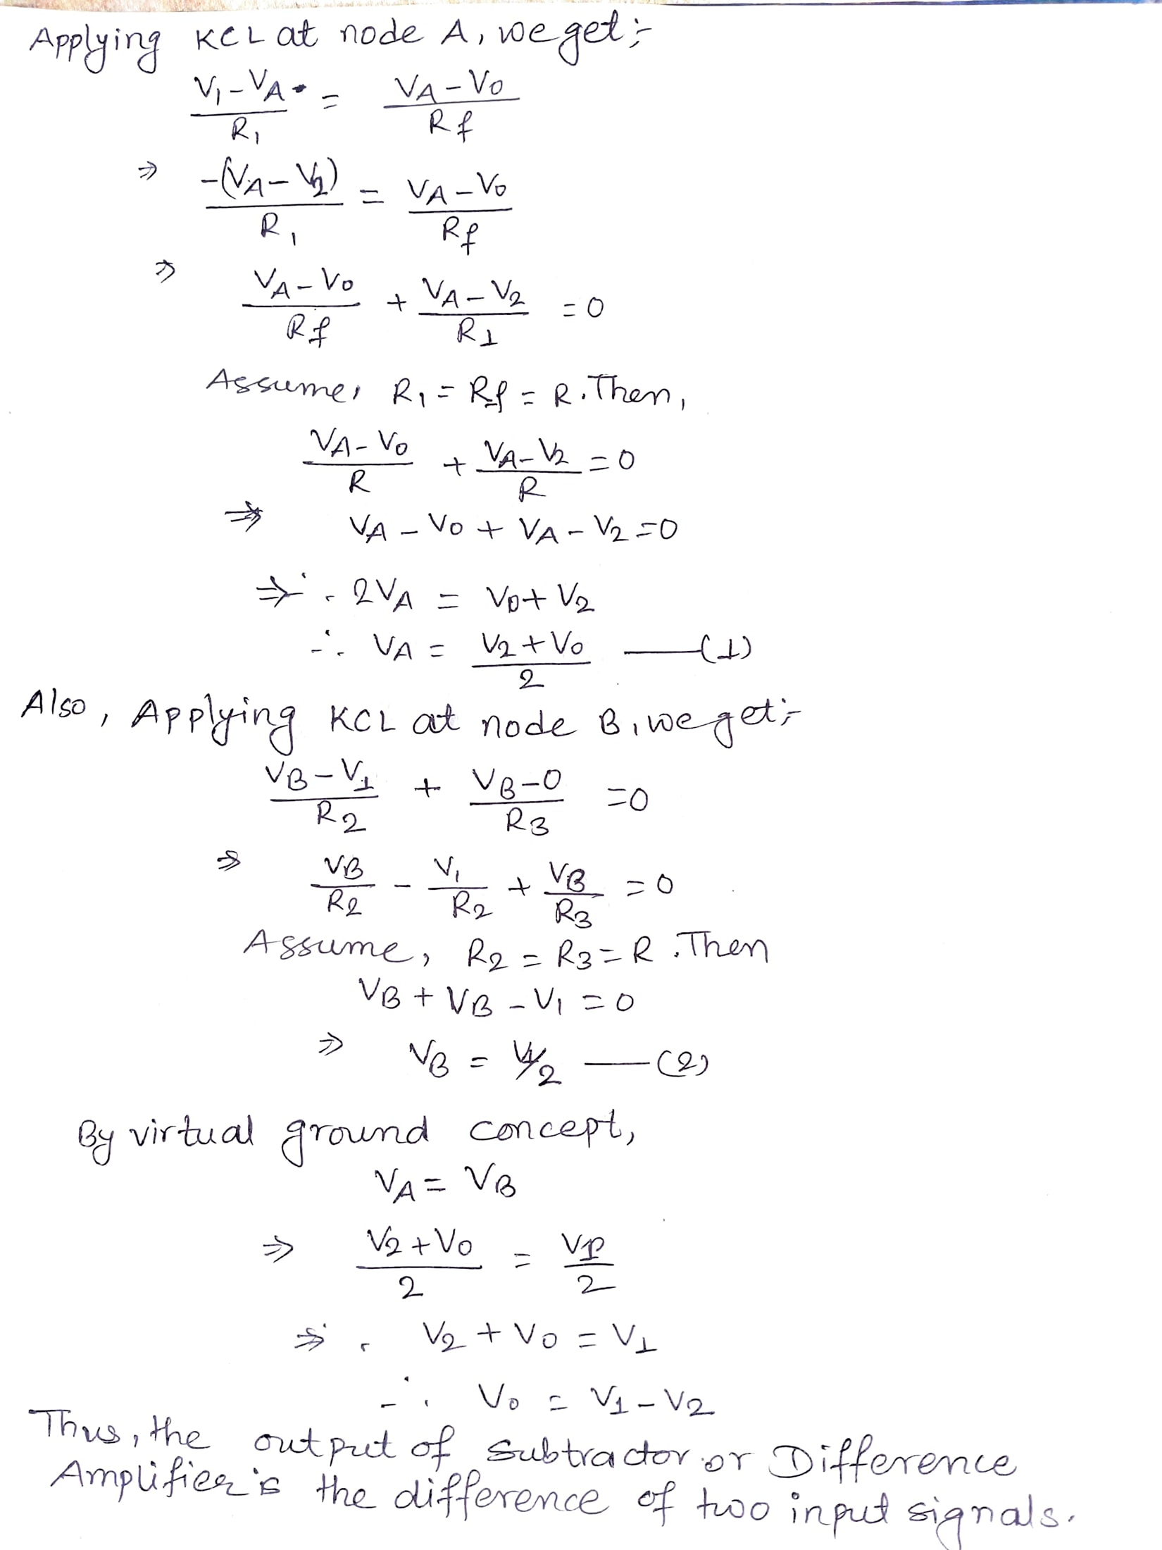

Slide 12
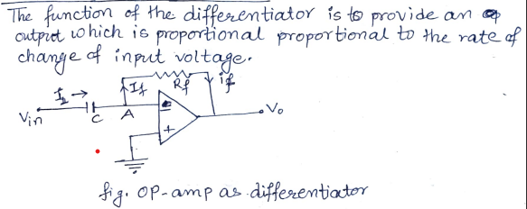
1.4.3 Differentiator

Slide 13
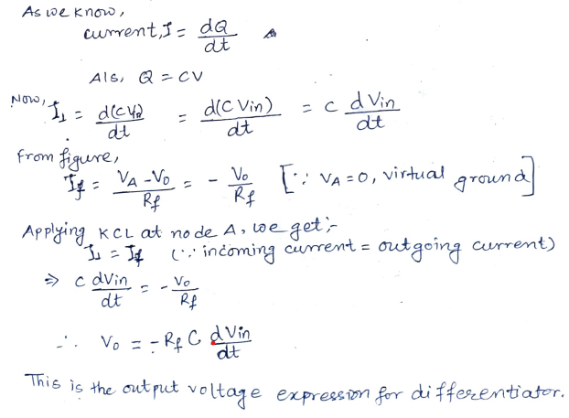

Slide 14
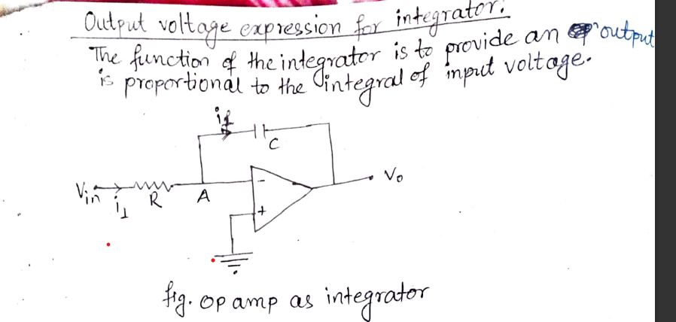
1.4.4 Integrator

Slide 15
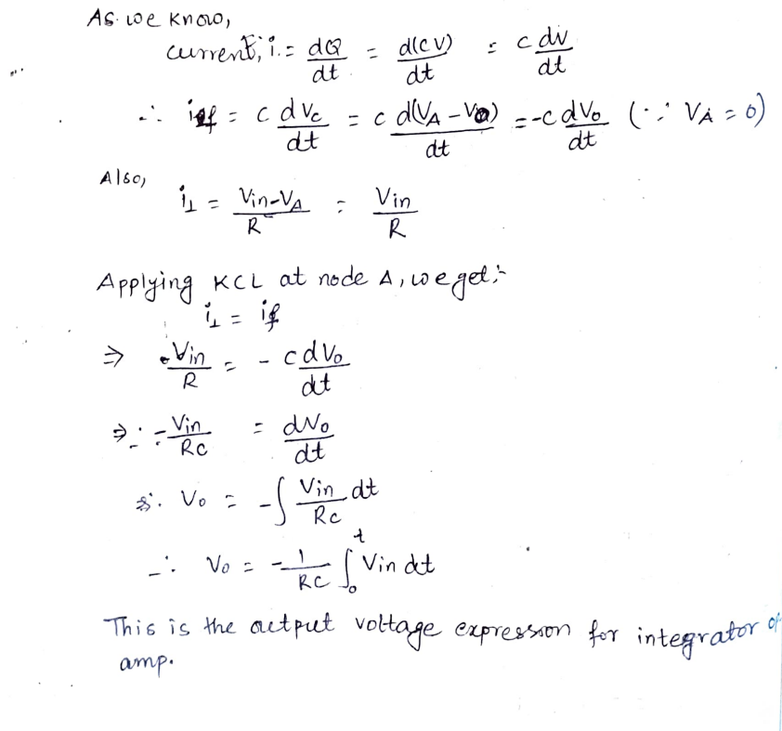

Slide 16
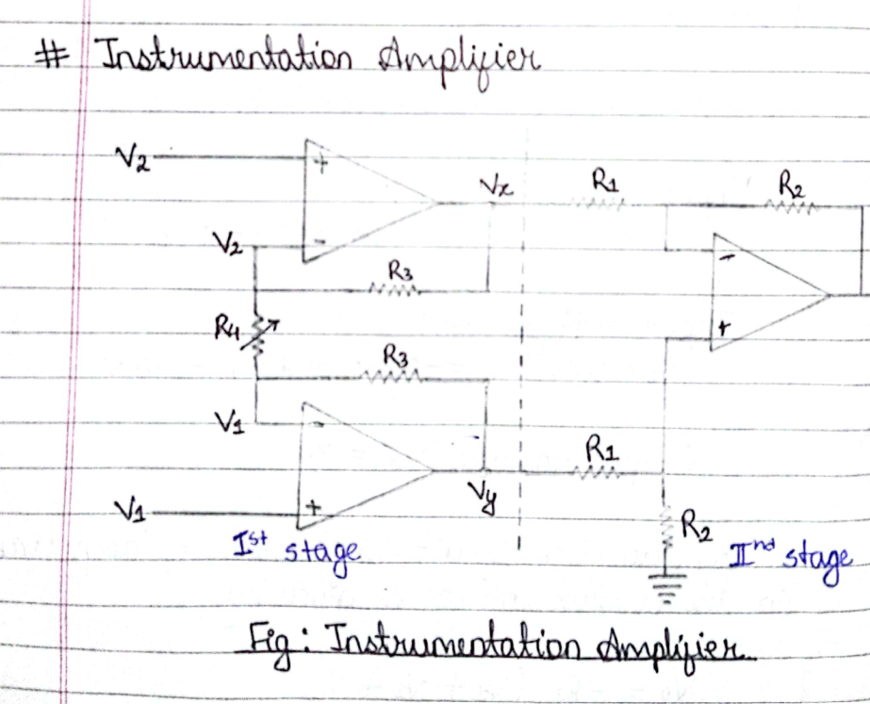
1.5 Instrumentational Amplifier

Slide 17
